Slide 1
Unhappy With Where You Live? Here’s What You Should Consider
ISYE 312
Group 14
Chris Duffy, Ian Leonhardt, Olivia Vitale, Ryan Susilo

Slide 2
Intro
The World Happiness Report portrays the level of happiness in countries throughout the world and helps to explain personal and national variations in happiness
This landmark survey continues to gain global popularity among governments, organizations, and civil societies who reference happiness indicators in efforts to better their policies
The research we conducted was focalized on how this data could be utilized when helping advise someone on what factors they should consider before moving to a different country
We used RStudio and Python to draw our conclusions

Slide 3
About the Dataset
The World Happiness Report uses data from the Gallup World Poll to determine happiness scores
We used both the 2021 and combined (2008-2020) reports
It contains 8 variables and 1,949 rows. The variables are:
Country, Year, GDP, Social Support, Life Expectancy, Freedom to Make Life Choices, Generosity, and Perceptions of Corruption
The target is trying to predict the happiness score (or “Life Ladder”), which is a continuous, moving value
Notes:
The first report was conducted in 2005 and our dataset utilizes all the data up until 2020. We also utilized the 2021 report which is separate and contains a regional indicator. The happiness scores utilize data from the Gallup World Poll. The survey is conducted by asking the participants to rate their current lives on a scale from 0 to 10 by imagining a ladder, hence the name in the dataset itself. Six factors are included in the dataset regarding the happiness score: GDP, social support, life expectancy, freedom, generosity, and corruption. The goal of the factors is not to impact the total score, but to show how each of them explain the overall happiness score
The World Happiness Report dataset contains 8 variables and 1,949 rows. The variables are as follows:
Country: Country where the data was polled from
Year: The year the data was collected
GDP: Gross domestic product, or the economic production
Social Support: A support system in times of need/crisis
Life Expectancy: Average lifespan of people
Freedom to Make Life Choices: Presence of free speech, actions, beliefs, etc...
Generosity: Response to “Have you recently donated to charity?”
Perceptions of Corruption: Within the government, state and local, and corporations
The target is trying to predict the happiness score (or “Life Ladder”), which is a continuous, moving value. The variables GDP, social support, life expectancy, freedom to make life choices, generosity, and perceptions of corruption are all continuous. The variable country is categorical and year is discrete.

Slide 4
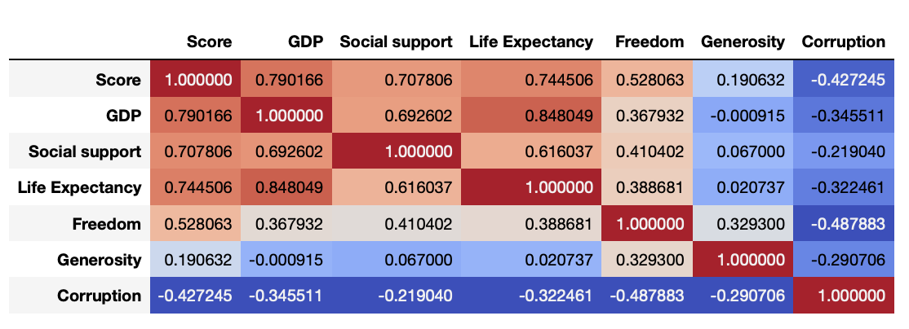
Exploring the Dataset
Right off the bat, we see there’s a very strong correlation between happiness score and GDP, Social Support, and Life Expectancy, so that’s where we’ll start
Notes:
We began our research by first observing the correlation between the six factors that explain the overall happiness score and the happiness score itself.
From this analysis we concluded that GDP, social support, and life expectancy weigh the most on the happiness score and decided to focus our attention there.

Slide 5
Our Approach
The goal of our research was to be able to put together a report explaining the trends in world happiness, ultimately serving as a resource to someone who may be unhappy with their current state of living and is seeking a move. In order to do this, we tried to answer the following 3 questions:
Does the economic stability of a country (GDP) have an effect on the happiness of those living there?
How does the level of social support found within a country contribute to its happiness?
How does a country’s life expectancy affect its happiness? What does this mean on a deeper level?
Notes:
Happiness is often a factor that isn’t considered when talking about different countries, however it is arguably one of the most important aspects in life to have. In order to research this, we tried to answer the following 3 questions:
Does the economic stability of a country (GDP) have an effect on the happiness of those living there?
How does the level of social support found within a country contribute to its happiness?
How does a country’s life expectancy affect its happiness? What does this mean on a deeper level?

Slide 6
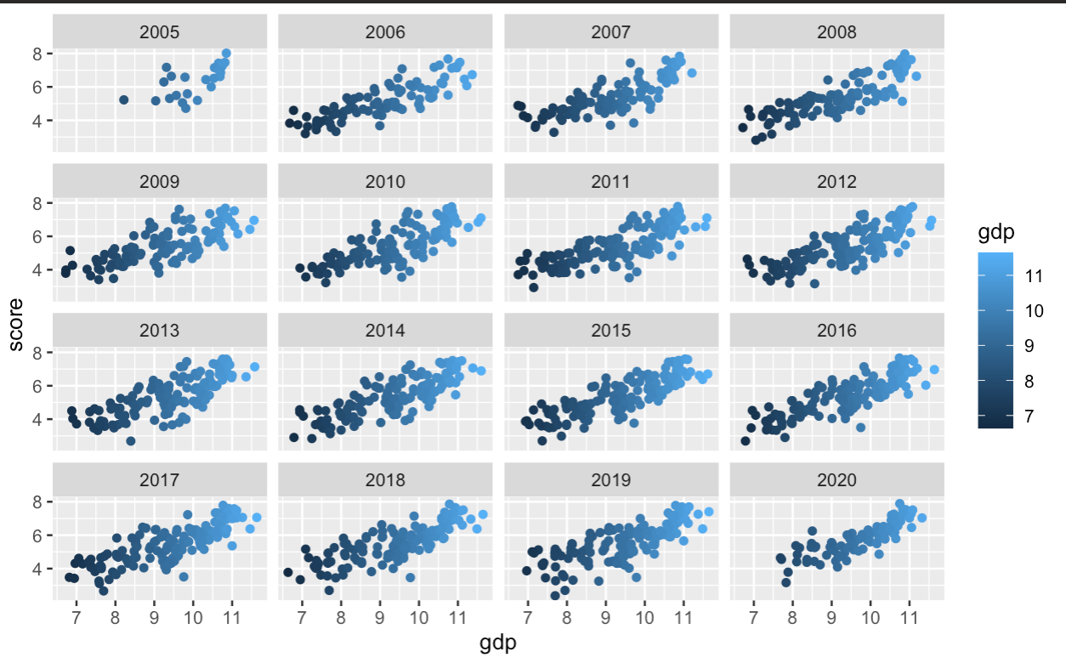
GDP vs Happiness Score History
Notes:
When considering the overall happiness, there is a certain notion or stereotype that money buys happiness and will fix anyone’s problems. Analyzing the effect of a country’s economic stability on its overall happiness is a way in which this theory can be looked into.
We started off by looking at GDP vs Happiness scores in a scatter plot form over the past years. It can be seen from these plots that not only does economic stability have a correlation with happiness, it has an extremely strong positive linear correlation that has been proven over the 15 years with these scores. Following this visualization, it seems that a simple linear regression model would be able to capture this trend and be able to predict the estimated happiness score of a country.

Slide 7
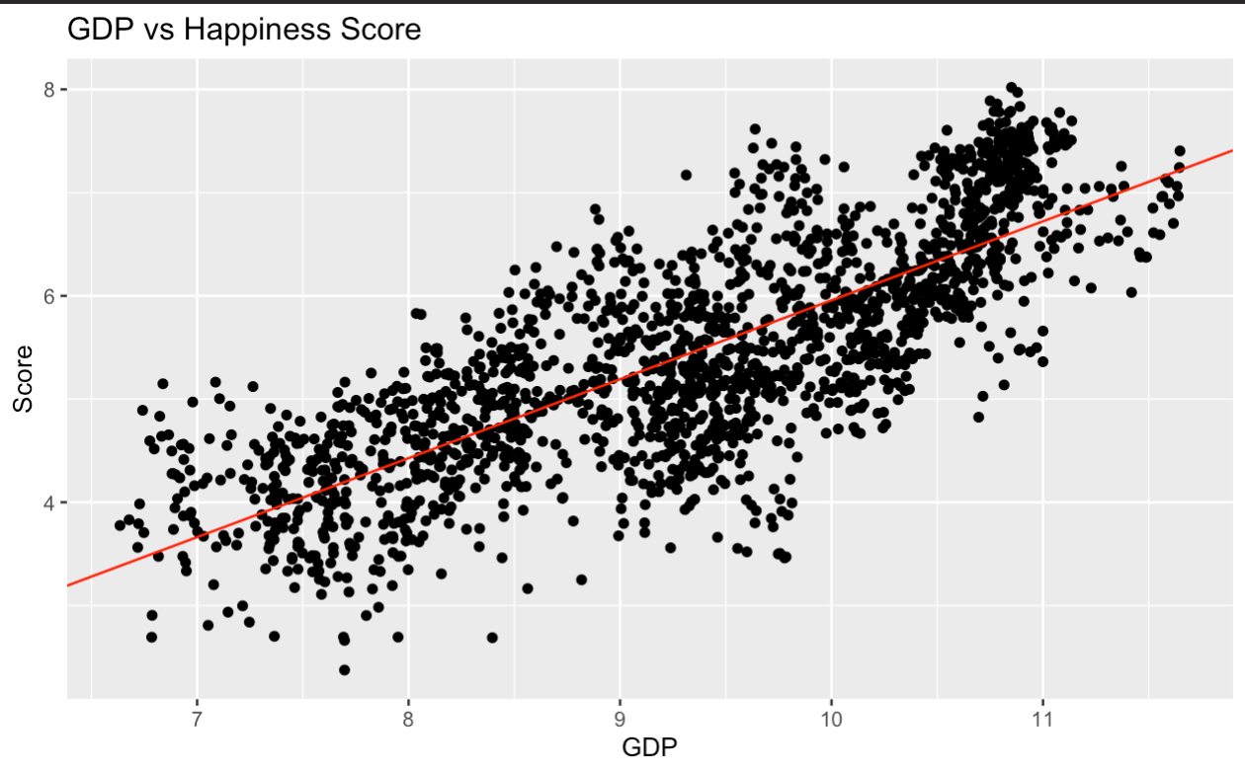
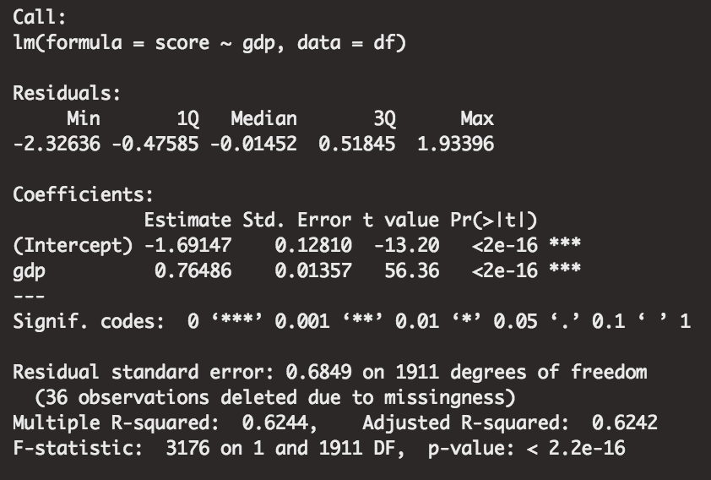
GDP vs Happiness Score Model
Notes:
The black dots, representing each country’s GDP and score over the year, appear to follow along with the linear regression model shown by the red line. With very outliers, there don’t seem to be any data points that are predicted wildly wrong. There is however one section in the top right of the graph where there is a strong concentration of data points above the model prediction. This can be explained by the concept that after a certain point, money is no longer able to buy more happiness and there must be other means to increase happiness. In addition, there appear to be countries that have high GDPs but low happiness scores. After further analysis, it is found that these data points mainly come from the country of Botswana. Botswana has a huge income inequality among its citizens which is most likely the biggest contributing reason as to why their GDP could be higher, but happiness lower.

Slide 8
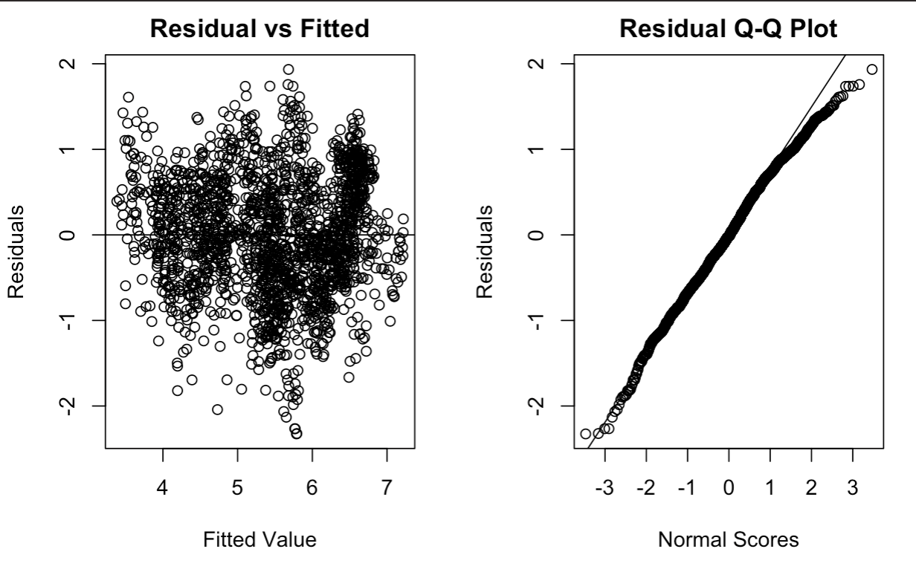
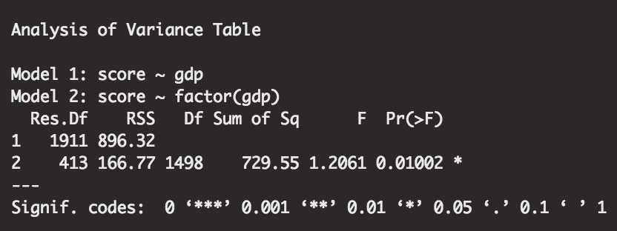
GDP vs Happiness Fit Test
Notes:
In order to confirm that this model is statistically significant, tests and visualizations were performed. The following shows how the fitted values match up with the residuals. It can be seen from these plots that the model performs well on the data and is able to predict the happiness scores within 2 for almost every single country. The slight deviance at the top of the QQ plot on the right can be explained by the outliers previously mentioned. It’s important to not only consider GDP as there are many factors that could be playing a role in influencing the happiness level of a country.

Slide 9
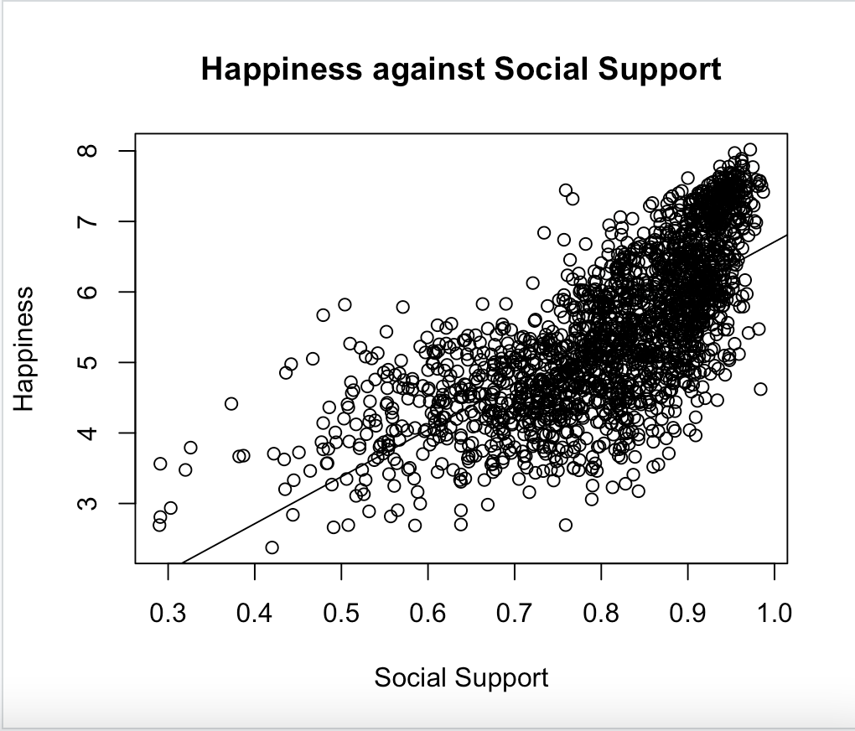
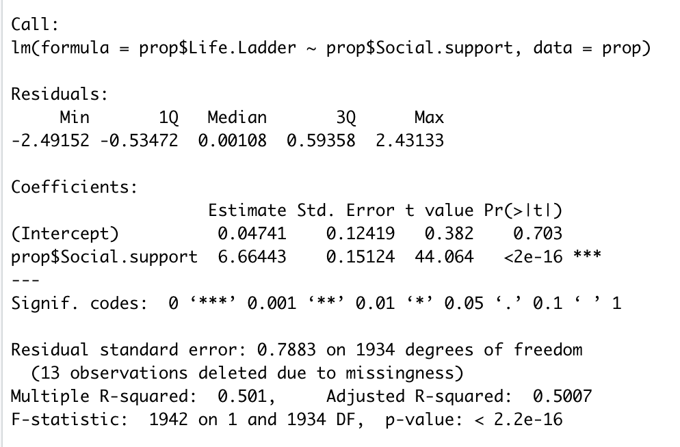
Social Support vs Happiness Score Model

Slide 10
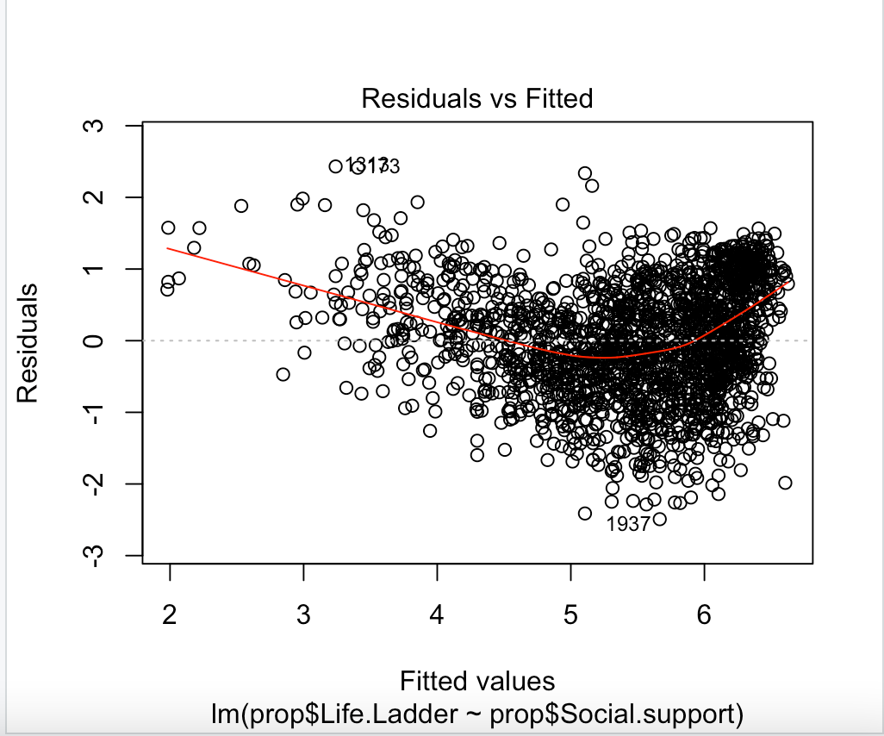
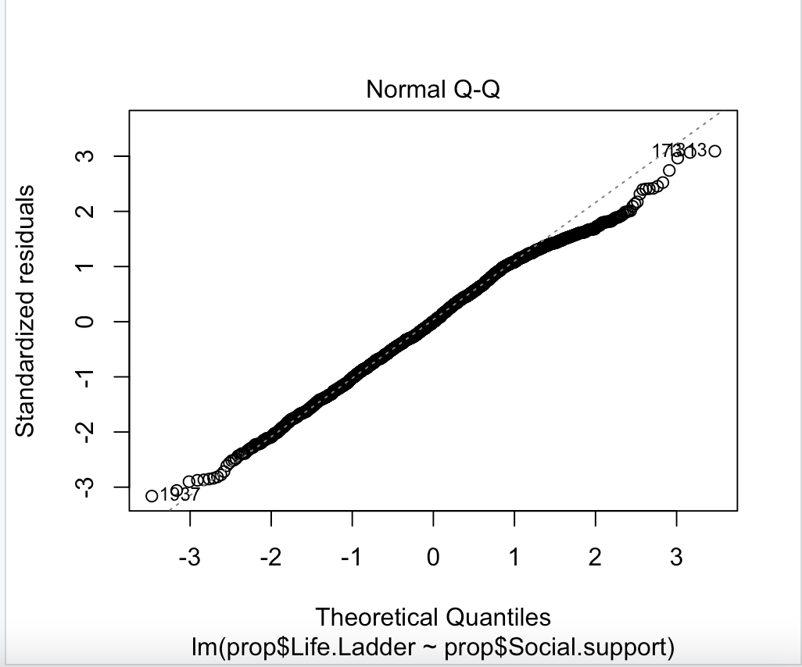
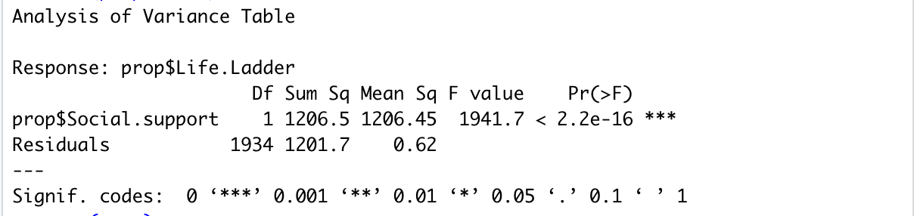
Social Support vs Happiness Fit Test
Notes:
Include anova table

Slide 11
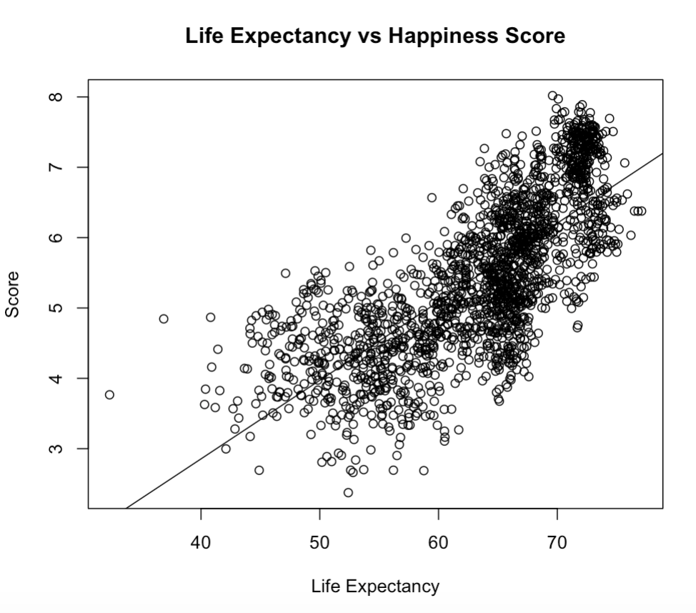
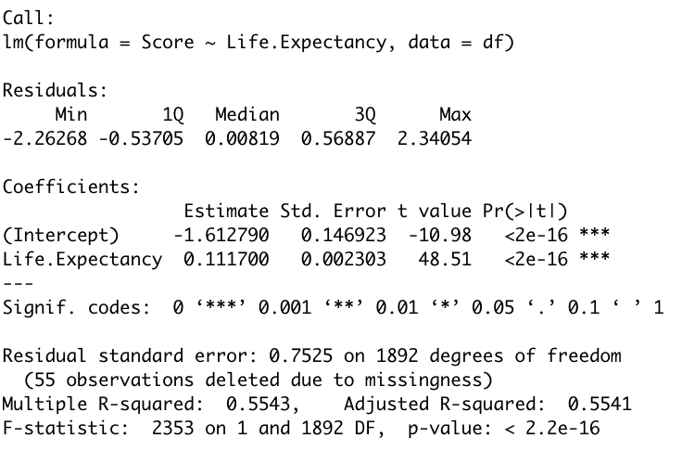
Life Expectancy vs Happiness Score Model
Notes:
To analyze how the expected life expectancy of a country may weigh on that country’s overall happiness, we conducted a linear regression model. Each circle represents the life expectancy and overall happiness score attributed to a specific country. As seen by the graph, life expectancy and happiness follow a linear distribution. Majority of the points hug the y=x line, with the exception of a dense portion in the top right. The R-squared value is 0.5541 which means that the regression function fits the data relatively well, but not perfectly. This could be explained by the fact that it’s rare for a given country to have an average life expectancy greater than 73. Thus, when you reach that point, life expectancy is no longer the only factor influencing overall happiness, resulting in a 1 point margin in happiness score, the 6.5-7.5 range.

Slide 12
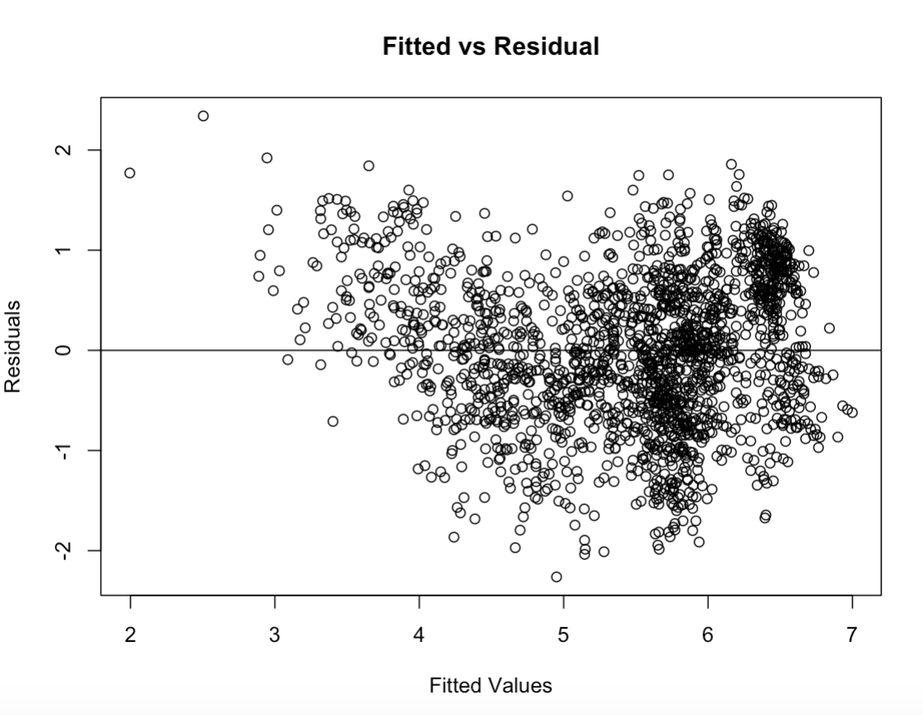
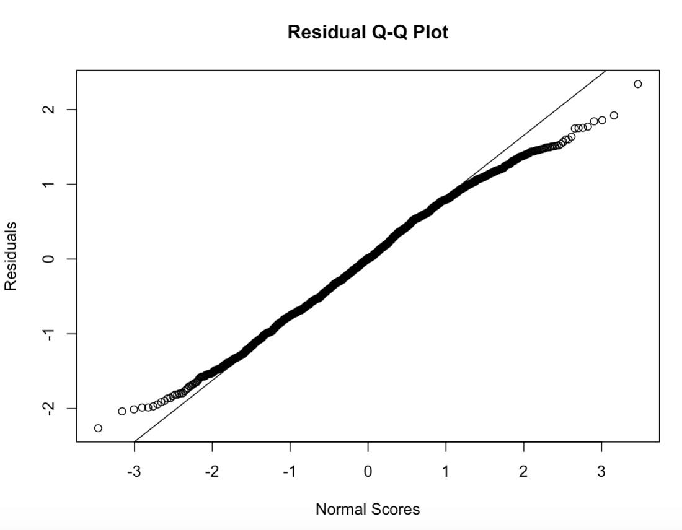
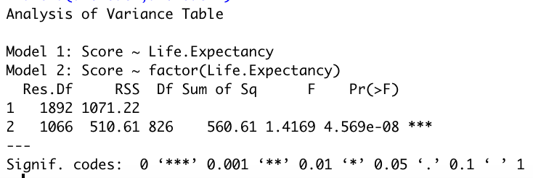
Life Expectancy vs Happiness Fit Test
Notes:
To try and confirm that this model is statistically significant we tested how the fitted values compare with the residuals.
The graph on the left represents the fitted values against the observed residuals. The plot contains points randomly scattered around the horizontal zero line, suggesting that, for the most part, the assumption that the relationship is linear is reasonable. A couple points in the top left corner stand out from the pack suggesting that there are a few outliers, as seen in the above linear regression plot. This can be justified by the fact that life expectancy isn’t the only factor affecting overall happiness.
The graph on the right represents the Q-Q plot which portrays the majority of the points following the y=x, representing that the data is fairly normally distributed, except for the tailends which make up the same set of outliers explained above. From these plots we can conclude that the model is able to predict the happiness score within 2 adequately for all of the countries.

Slide 13
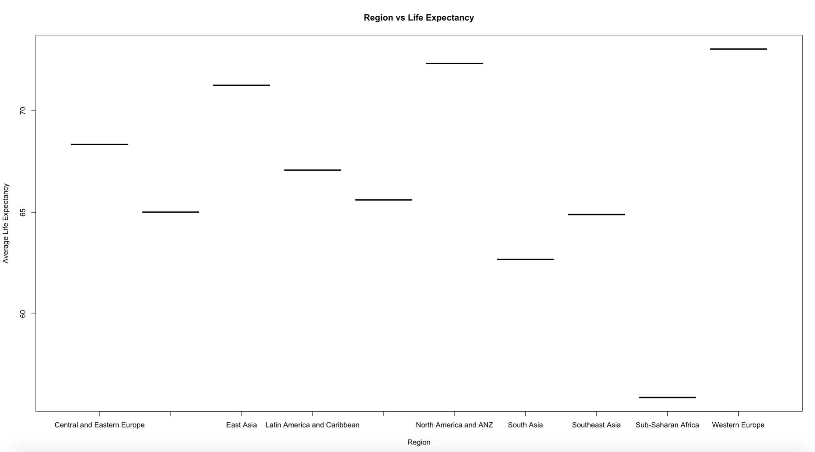
Geographic Location vs Life Expectancy
Notes:
After determining that life expectancy and score follow a linear relationship, we decided to graph the regional indicators against the average life expectancy of all of the countries found within that region in order to find the happiest regions.
In this plot you can see that the largest average life expectancies can be found in Central and Eastern Europe, East Asia, North America and ANZ, and Western Europe. Thus we concluded that the happiest countries, in regards to life expectancy, can be found in those regions. These results are possibly representative of the better health care systems, reduced violence and drug and/or alcohol use, as well as the cheap, or free, education found in these regions.

Slide 14
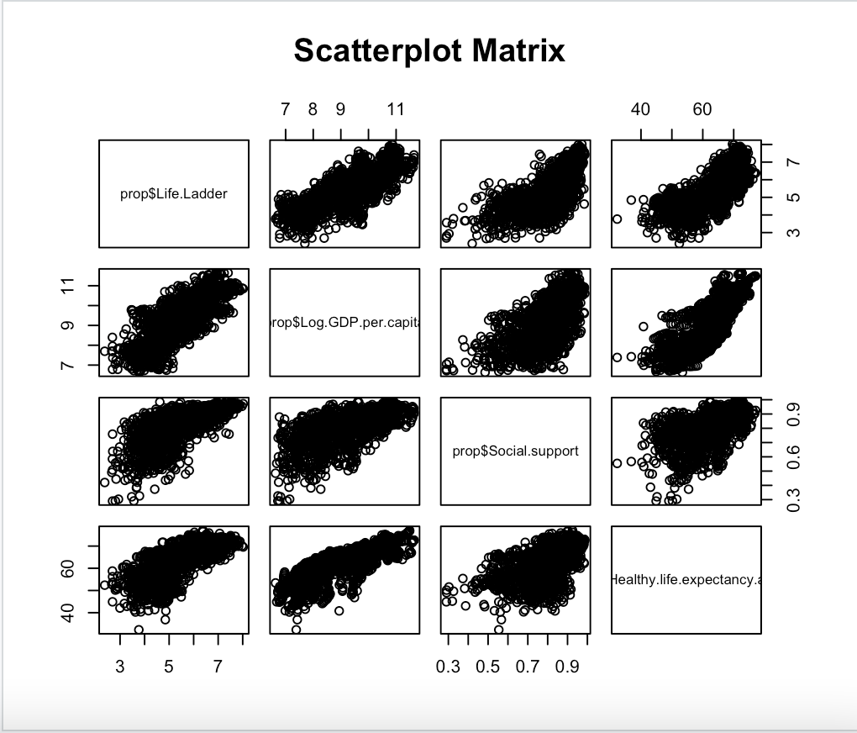
Scatterplot Matrix
Notes:
This scatterplot matrix visualizes the relationship between combinations of variables.

Slide 15
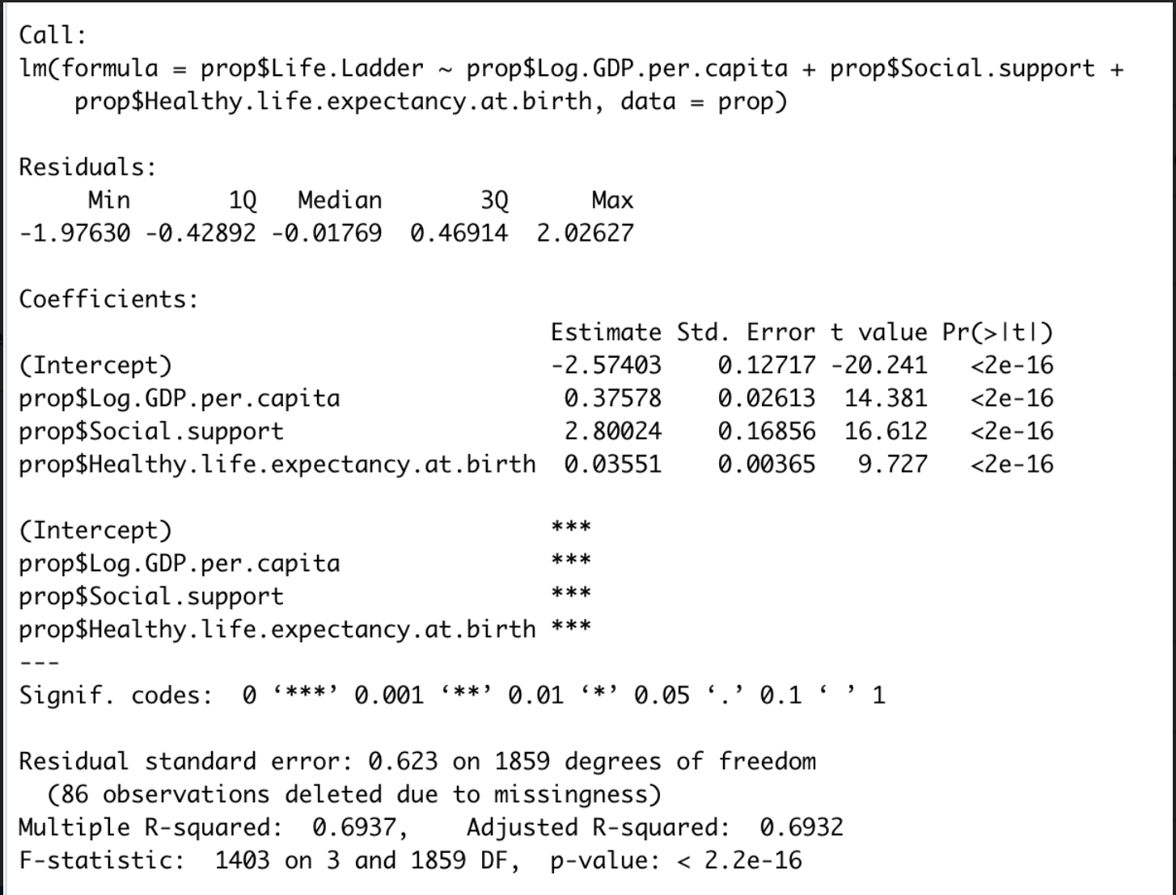
Multiple Linear Regression Model
Notes:
Looking at the model combining these three variables, The R-squared value is 69.37%, meaning that this model explains 69.37% of variation in happiness. This value is okay, so we looked more closely at the assumptions in this model. Outliers and influential cases, multicollinearity, and residuals.

Slide 16
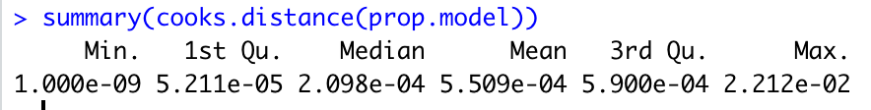
Outliers and Influential Cases
Notes:
In order to find outliers we looked at the standardized residuals. Under the assumption that standardized residuals greater than 3 are deemed outliers, we looked at the percentage of values with a standardized residuals outside of this range. Shown in the first output, 0.3% of our values are outliers, which is too low to significantly affect our model. Next looking at influential cases, no values have a cook’s distance greater than 1, meaning there are no influential cases

Slide 17
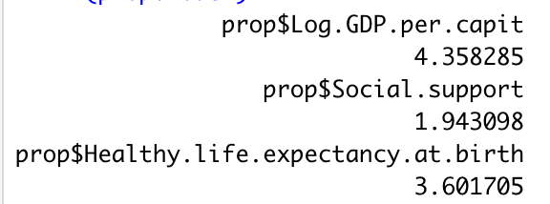
Multicollinearity
Notes:
VIF larger than 10 indicate multicollinearity. These three values are all less than 10, so there is no multicollinearity

Slide 18
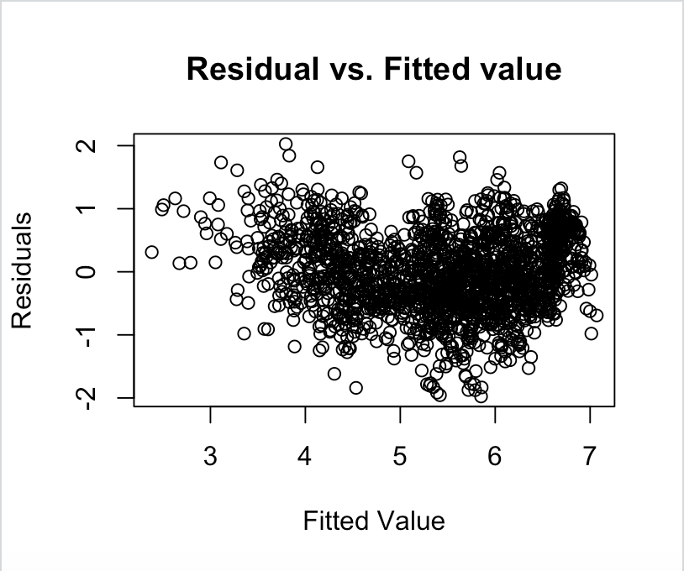
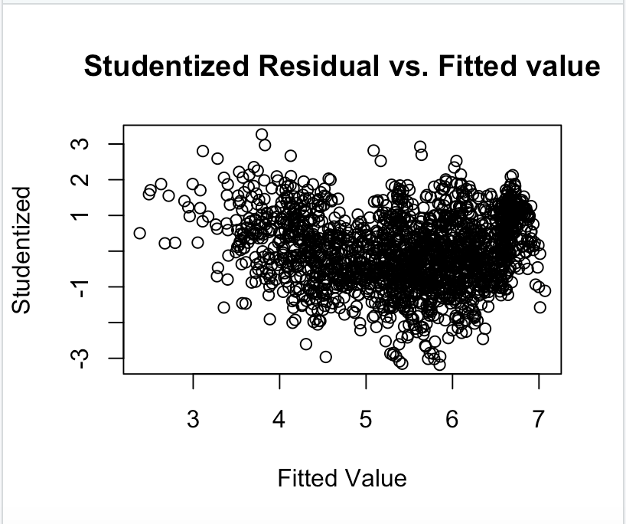
Residuals
Notes:
Both the studentized residuals and residuals vs. the fitted values show somewhat of a U-shaped pattern, which lead us to investigate transforming y to natural log of y to fix this non-linear relationship

Slide 19
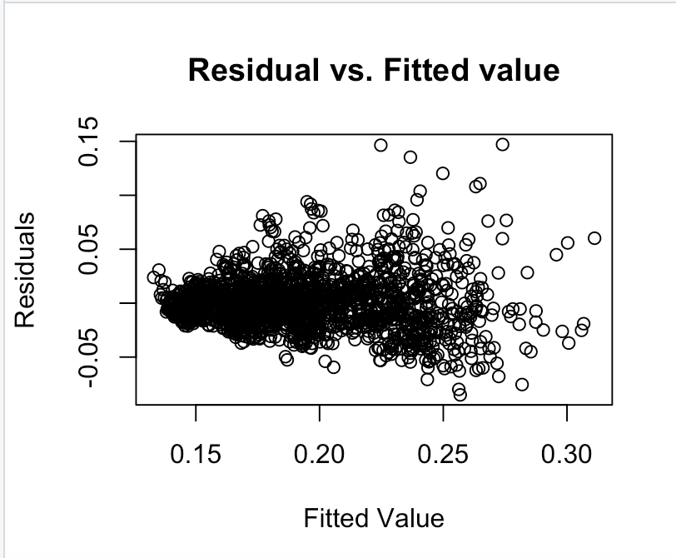
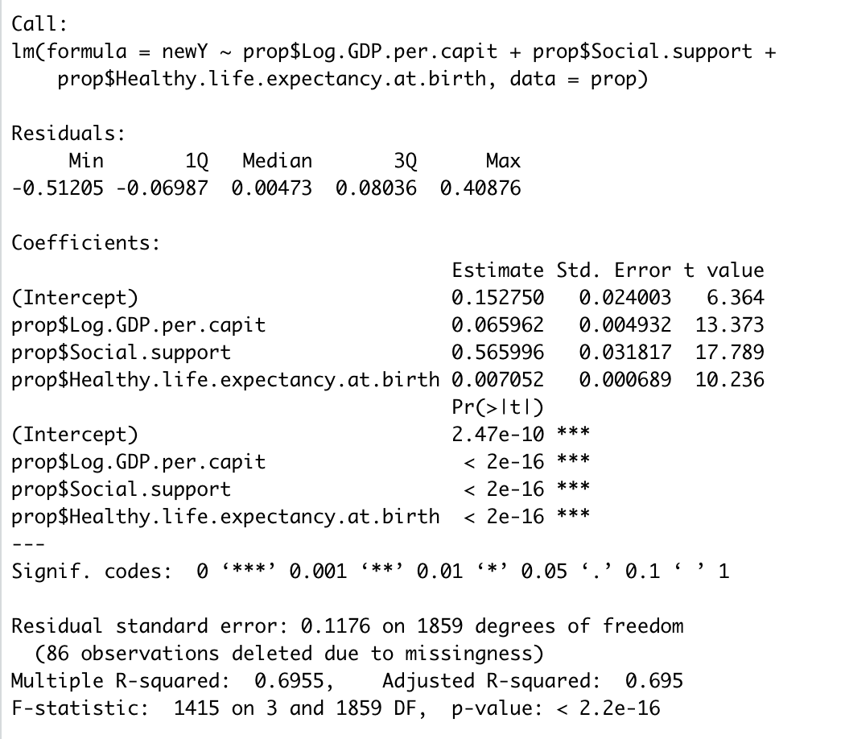
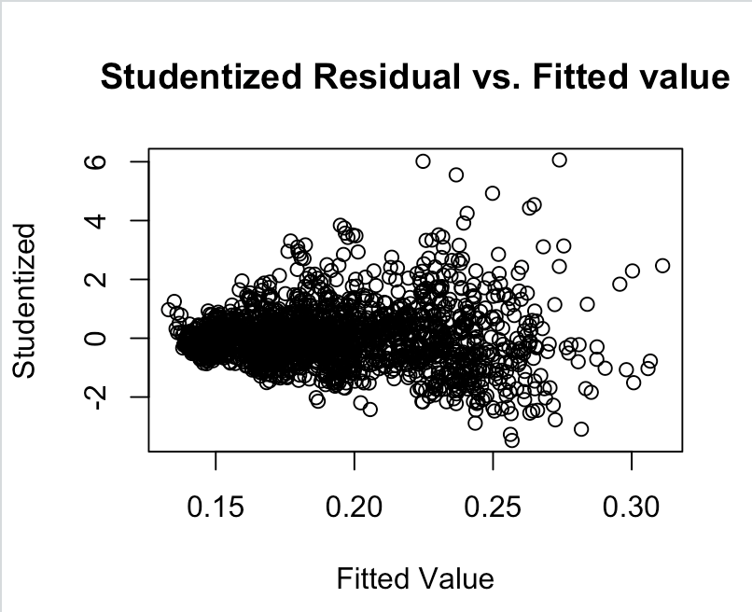
New Model
Notes:
This transformation fixed our problem, both plots show more randomized pattern around the horizontal line at 0. The r-squared value of our new model is 69.55% which is higher than the previous models r-squared value, proving there is some non-linearity in our dataset

Slide 20
Conclusion
GDP, Social Support, and Life Expectancy all have linear relationships with the overall happiness found in a country
These 3 variables are the most correlated with the score
Each one provides good insight into predicting how happy you will be, yet there are multiple variables that go into the score
Thus, someone who is planning on moving to a country should look at all of the factors before making a decision, but place the largest weight on GDP, social support, and life expectancy

